Slide 1
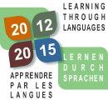


8th International Conference on Language Teacher Education
George Washington University
1 June 2013
Preparing Language Teacher Educators to Meet National and Global Needs
CARAP/FREPA: A new way of learning through languages
Laura Ambrosio
University of Ottawa

Slide 2
CARAP
FREPA
A Framework of Reference for Pluralistic Approaches to Languages and Cultures

Slide 3
« Introduction to the Framework of reference for a pluralistic approach (FREPA) proposed by the ECLM (European Center for Modern Languages)
ECLM Mandate – European Context
Planning with pluri-approaches
FREPA : Glossary and terminology
Association Global and Specific Objectives
Adaptation of existing material: select, adapt, create
Evaluation tools – FREPA, Common European Framework
Ideas for more cultural integration

Slide 4
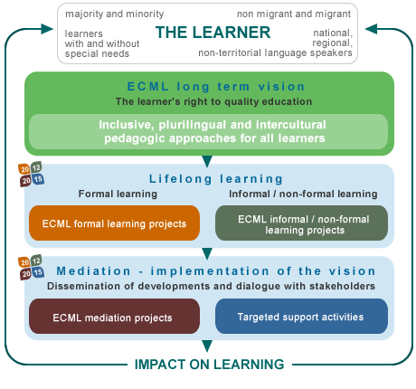
Quick overview ECLM http://www.ecml.at/Programme/Programme20122015/tabid/685/language/en-GB/Default.aspx

Slide 5
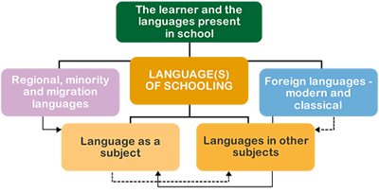
Quick overview ECLM http://www.ecml.at/Programme/Programme20122015/tabid/685/language/en-GB/Default.aspx

Slide 6
Quick overview ECLM – Pluralistic approaches
The term “pluralistic approaches to languages and cultures” refers to didactic approaches which use teaching / learning activities involving several (i.e. more than one) varieties of languages or cultures.
This is to be contrasted with approaches which could be called “singular” in which the didactic approach takes account of only one language or a particular culture, considered in isolation. Singular approaches of this kind were particularly valued when structural and later “communicative” methods were developed and all translation and all resort to the first language was banished from the teaching process.
FREPA is based on four pluralistic approaches

Slide 7
Pluralistic approaches
Awakening to languages
Intercomprehension between related languages
Intercultural approach
Integrated didactic approach to different languages studied

Slide 8
What does FREPA mean for Canada?
Connection with reality of the classroom where many cultures are more and more in contact
Connection with IL Program in particular where language is no longer to be seen as a one element to learn but as an ensemble of cultural contexts
Platform for developing curriculum activities that foster identity, sharing and appreciation of the culture of the other
Theory of competences and ressources linked with overall objectives and specific objectives of IL Curriculum

Slide 9
What does FREPA mean for Canada?
Approaches to develop and measure
Abilities
Performance
Competences
Programs
Teaching
Objectives
Knowledge
Attitudes
Skills
Culture
Inter-competences
Inter-disciplines
Music/Drama
Humanities
Literature
Languagess (pluri)
Manage
Construct

Slide 10
FREPA Glossary and terminology
Competences and ressources
Knowledge
Par éveil aux langues, par Intercompréhension, par didactique intégrée, par l’interculturel
Attitudes
Par éveil aux langues, par Intercompréhension, par didactique intégrée, par l’interculturel
Skills
Awakening to languages
Intercomprehension of related languages
Intercultural Approach
Integrated didactic approach to different languages studied

Slide 11
FREPA Competences
The competence to manage linguistic and cultural communication within a context of otherness
The competence of constructing and developing a pluralistic repertoire of languages and cultures

Slide 12
Ressources
Descriptors for « Culture »
K. Knowking that each culture determines / organizes , at least partially, the perception / a vision of the world, a way of thinking the world/ a way of thinking of the community
K. Knowking that we can use similarities between languages (structure, discurse, pragmatics) to learn languages
S. Being able to formulate hypotheses in order to analyse linguistics or cultural unfamiliar situations
S. Being able to compare diffent discourses used or available in own mother tongue with the ones of other languages
A. Being able to develop sensitivity to linguistic or cultural differences
A. Being open (and fight personal resistances) toward what seem to be incomprehensible or different
.
. Knowledge = K
. Skills = S
. Attitudes = A

Slide 13
Planning
More than a single lesson – Idea of competence
Plan a school « matinée» or a MET production
Plan an excursion (Concert Hall, specialized school – drama – music – musical or opera)
Invite arts specialists, with school programs some free) Mississauga choral society

Slide 14
Global and specific objectives
Possible organisation …
Selection of a theme - synopsis
Selection of one or more sources of documentation written or audio
Identification of possible tasks
Transition between the tasks
Stimulation: students’ imagination
Development of related themes
The competence to manage linguistic and cultural communication within a context of otherness
Programs
Teaching
Objectives
Culture
Music/Drama
Humanities
Literature

Slide 15
Preparation
Posters
CD – DVD or access to WiFi
Opera Synopsis
Calendar of artistic events
Planning unit for cultural integration
Any possible additional ressources (web/paper/person) * not to forget Long Play Disks usually with multilingual libretti
Evaluation grids… what are we going to measure

Slide 16
Objectives
Global and traditional language objectives:
  Develop oral and written abilities (comprehension and production)
Specific objectives (possibilities):
  Identification of time-space elements
  Sub-themes recognition
  Ability of linking plot /story to a larger context
  Identification of language conventions of particular context
  Ability to formulate coherent responses
  Overall ability to discover « culture » via different means

Slide 17
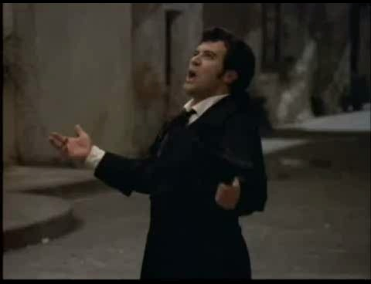
Largo Al Factotum

Slide 18
Activity of contextualisation
15 minutes
Use of an Opera excerpt
Identification emerging themes
Vocabulary recognition
Anticipation of possible content
Mot masculin | Mot féminin | Congénère

Slide 19
Expansion activities
Transfert of knowledge
15 minutes
Transfert of sociolinguistic knowledge
Linguistic mapping
Analysis of various levels of languages, speech and voices
Links between images, messages and meaning (both verbal and non verbal)
Approaches to develop and measure
Abilities
Performance
Inter-competences
Inter-disciplines
Langues (pluri)
Pluri-approaches

Slide 20
Brainstorming 15 minutes
Identification of four themes associated with play, opera, musical, drama titles/plots
Oral justification of the choice (comparision of choices made by other students
Amour | Beauté | Commerce | Secret

Slide 21
Audio – Video - Text
La calunnia è un venticello
« The power of music»
Listen to this « aria » from Barbiere…
What do you imagine listening…
How could you visually represent what you are listening to? What are your feelings when you listen?
Notes:
Sincères remerciements à
Johanne Bourdages
Marie-Josée Vignola
Mari Wesche
Claire Isabelle
Ont contribué à cette recherche:
Institut des langues secondes: direction, personnel, étudiants
CRSH
International Language Educators and Administrators
Bureau langues officielles
Les étudiants, Mes amis, mes professeurs, mes collègues,
et surtout,
Ma famille

Slide 22
Consolidation activity
(Social and cognitive strategies)
15 minutes
Posters and music: word, content analysis
Discussion and transfer:
  Question : Do you know any « factotum »?
  Question: What would be the best poster for an Opera?
Use of connecting words
Use of particular grammar, syntax, discourse

Slide 23
Reading activities
(Metacognitive strategies – Skimming)
10 minutes
Research and consultation of written documents
Opera houses around the world web sites
Thematic vocabulary as a pre-selection: What does mean the word…
Synopsis
Opéra bouffe/Opérette
Opéra sérieux…
Chinese Opera : Jingxi
Musical

Slide 24
Reading activities
(Metacognitive strategies – Scanning - Focus on form)
20 minutes
Generate a list of speech acts or possible dialogues
Looking for:
  Plots
  Descriptive elements
  Argument
  Translation into artistic variations

Slide 25
Comprehension activities
(Cognitive strategies – Organization – Grammar - Discourse)
40 minutes
True/False history/plot statements to choose
Reordering of the « true » events
Within these history/plot statements, find structures, grammar, vocaburary, expressions

Slide 26
Evaluation tools
Your own curriculum, with regards to
  Communication
  Comprehension and Knowledge
  Thinking, searching, organizing
  Identifying the type of speech
CER – CEFR Common European Framework of Reference (Council of Europe- ECML)
  Global scale
  Self-assessment/
  Specific evaluation grids

Slide 27

Behind the scene – Ansaldo
Teatro Alla Scala/at the MET/Others

Slide 28
Learning outcomes
Ideas for more tasks (within the competence)
  Be the « Shows newspaper critics »
  Elaborate publicity messages/ promotion campaign advertising
  Create new posters
  Imagine new scripts (based on same themes)
  Reconstruct a time line (On the history of Opera, on duration of Opera, on calendar of world productions live or HD)
  Who does what at the opera or in the opera?
  Elaborate a glossary of the 100 most important words of opera

Slide 29
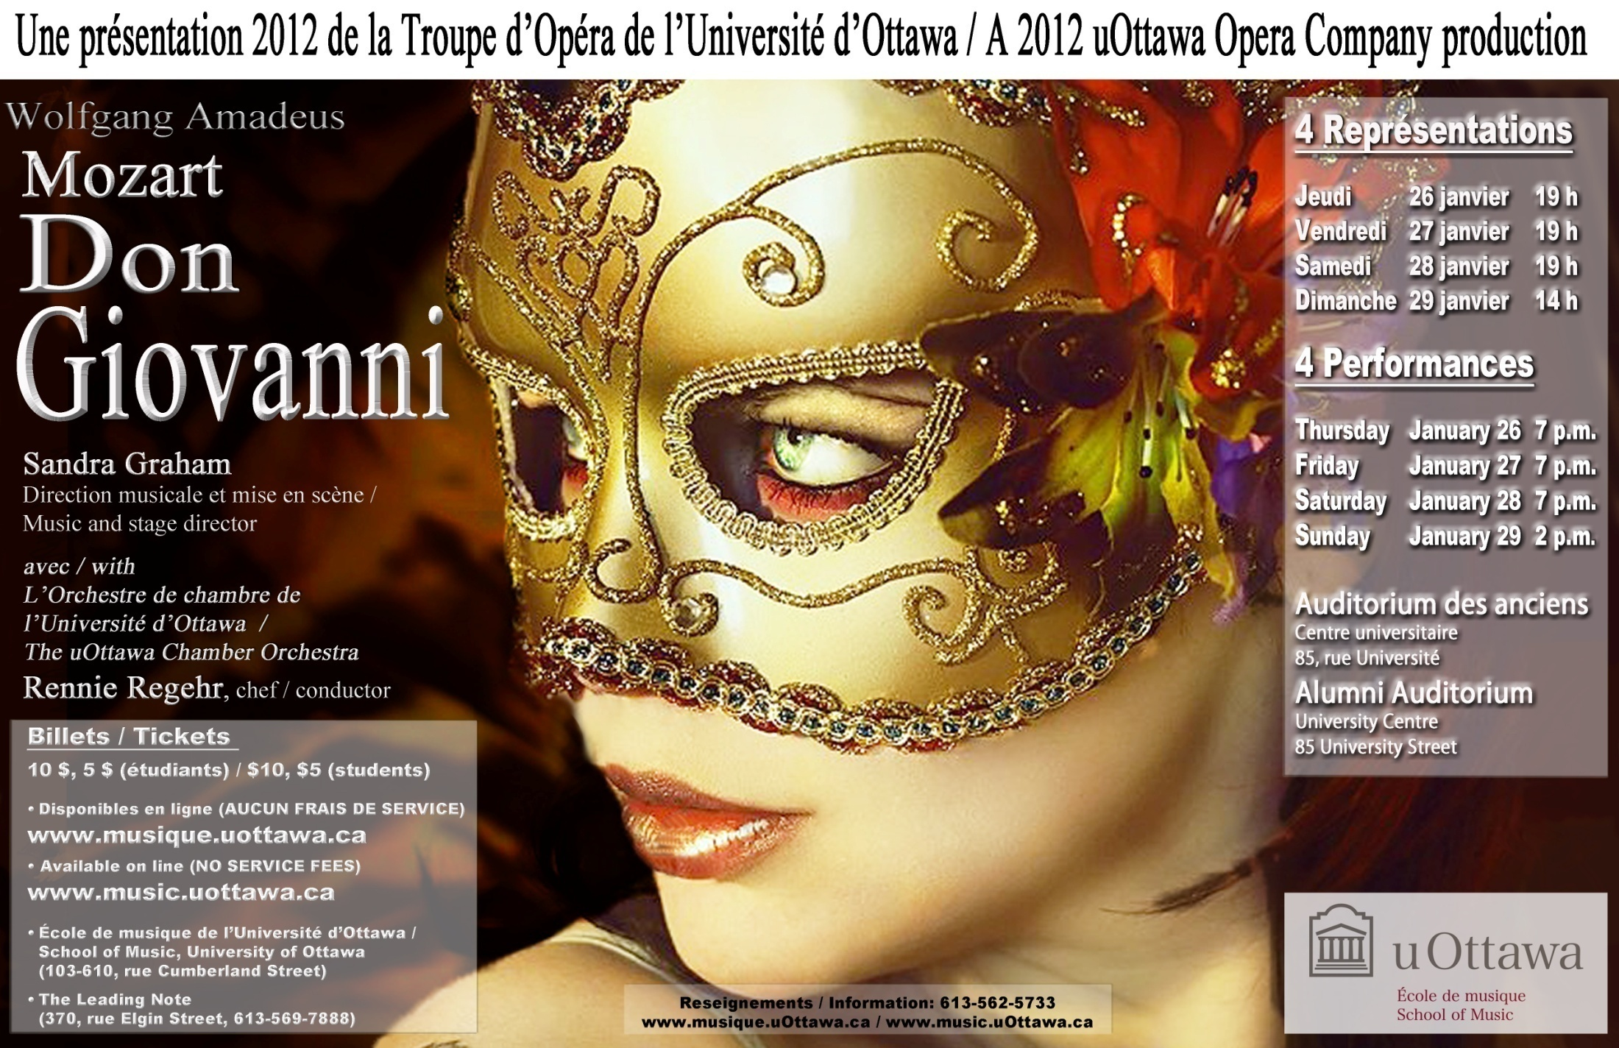

Slide 30
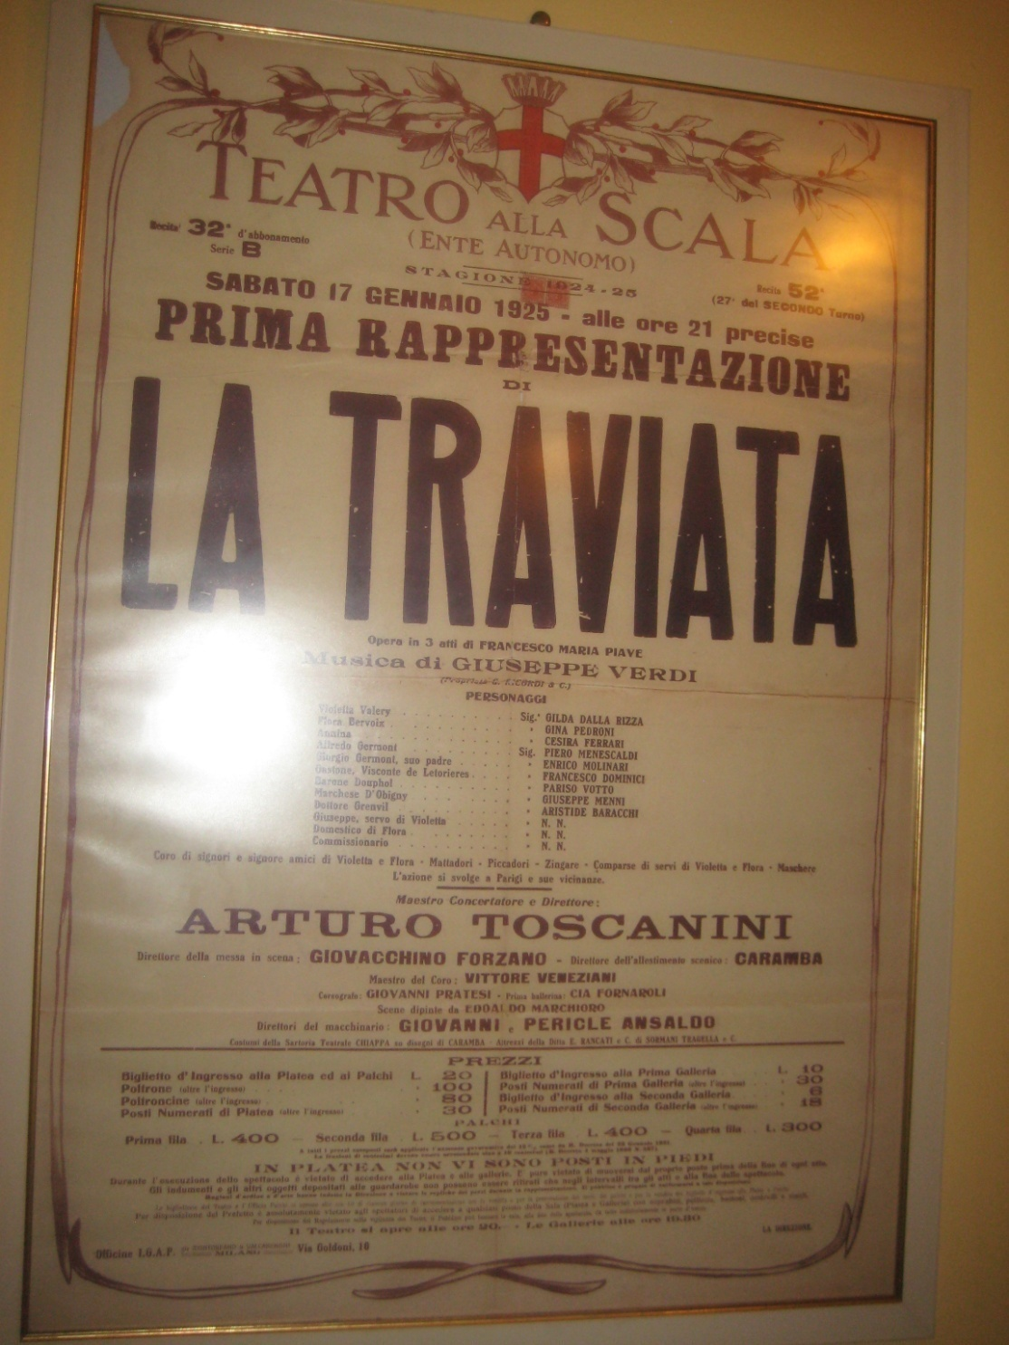

Slide 31
Guide pédagogique du Théâtre de Lille
(capitale européenne de la culture en 2004) http://www.opera-lille.fr/fichier/o_media/9225/media_fichier_fr_dp.la.traviata.pdf
Pour y trouver:
  Chronologie de la création de la Traviata (avec détails sur le texte original d’Alexandre Dumas
  Synopsis et argument
  Libretto de Francesco Maria Piave
  Une discographie et une vidéographie de différentes versions (en direct, film)
  Interprètes – Les différents genres de voix
  Le « qui fait quoi à l’Opéra »
  Vocabulaire de la scène, du bâtiment, de la musique

Slide 32
Teatro Alla Scala or MET who, how, when, why, what
Differences and similarities

Slide 33
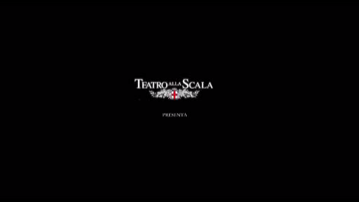
Reaheasal Hall - Interviews

Slide 34
Teatres and artistic concert halls around the world
History, Culture, Structure, Importance

Slide 35
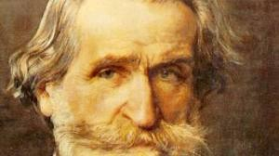
1813 - 2013 (Birth Bicentennial)
Giuseppe Verdi
History …
Viva V.E.R.D.I =
Viva Vittorio Emmanuele Re d’Italia
…Va pensiero…exodes, Today…

Slide 36
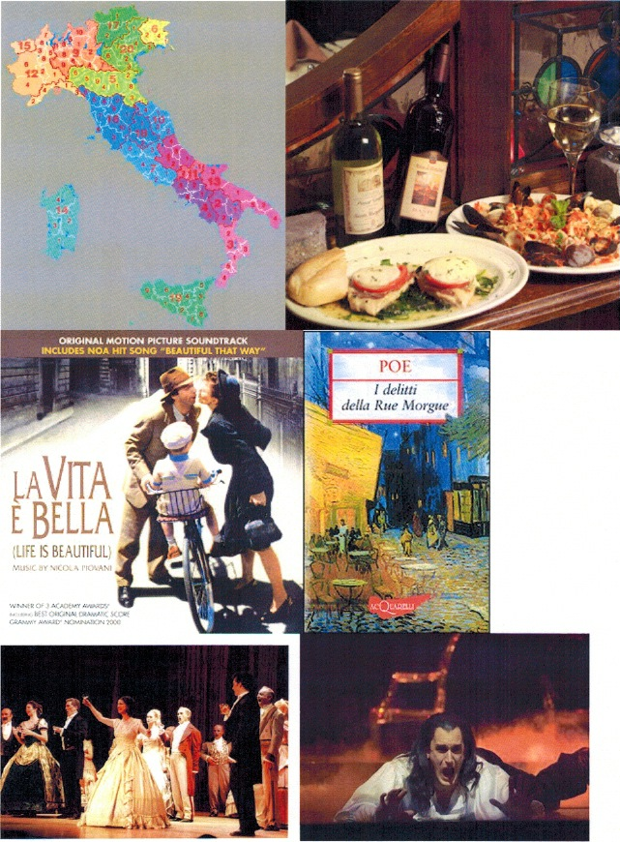
From Opera to:
Movies
Visual arts
Literature
Drama
Musicals
Circus
… Reality?

Slide 37
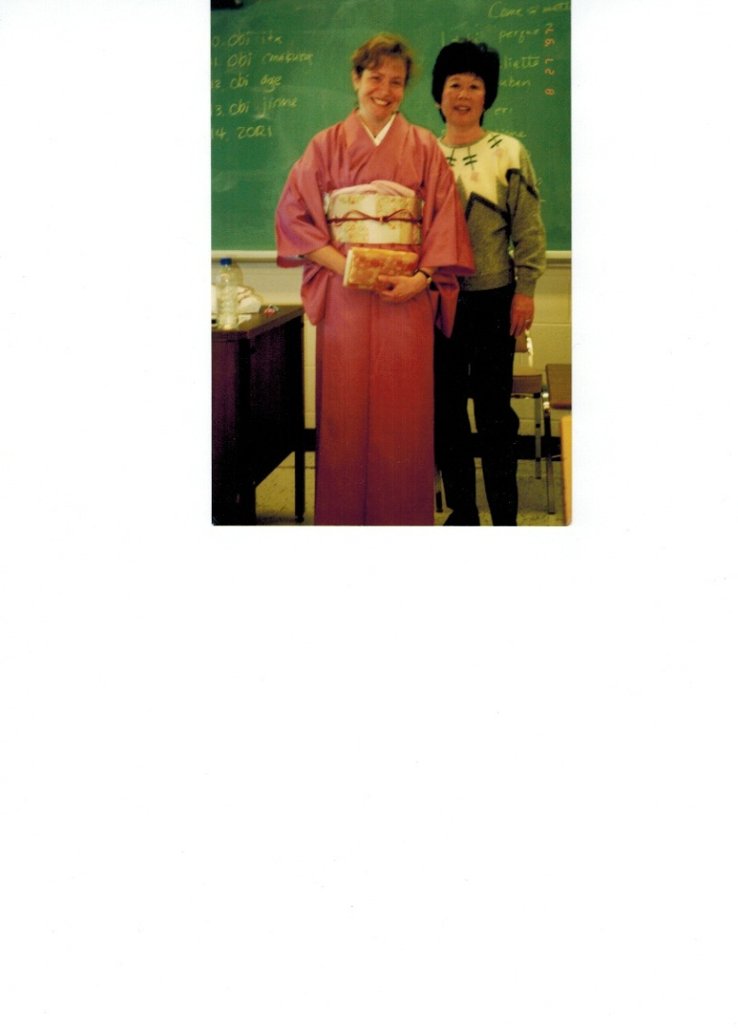
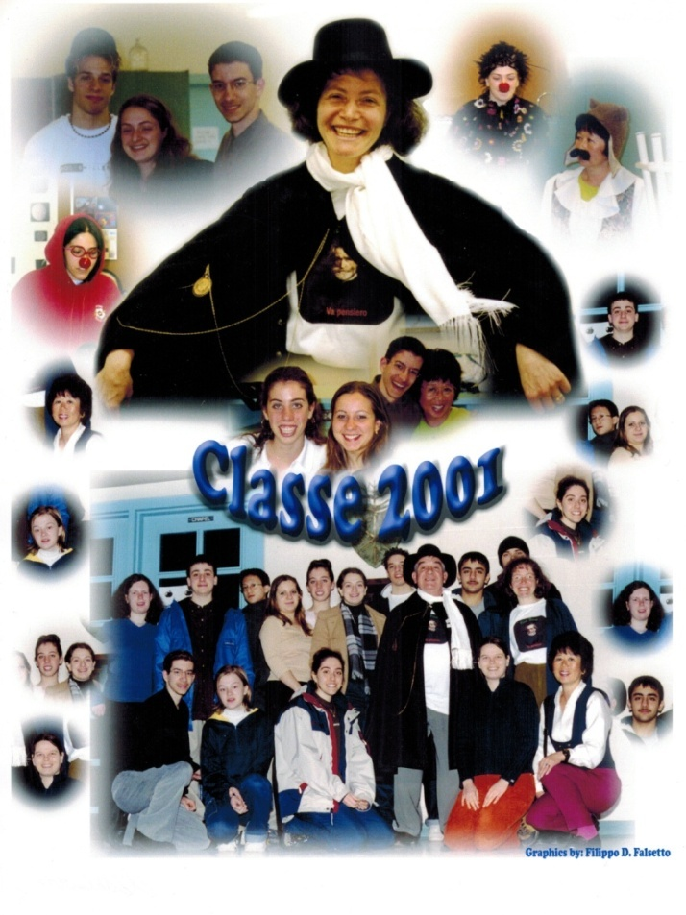
Cultural Class Travels with opera : from Italy to Japan (Puccini), Madama Butterfly/ to France (Berlioz, Offenbach) to Germany and IL classes in Canada…
Analyses of :
Fashion, Tradition, Casting, Decors
Historical anniversaries/ Commemoration of events
Comparing use of terminology in music and in dictionaries (Barcarolle – s -)

Slide 38
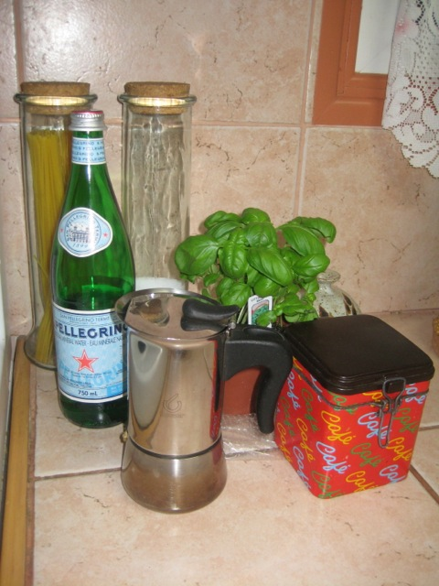
Clichés
Determining which approach would best explain a picture

Slide 39

From Opera to other interpretations:
King Singers – and more Rossini – Waht is on Youtube?

Slide 40
From Opera with FREPA to other topics:
Citizenships and solidarity
And you? What is your culture, your citizenship?
Ideas for further discussion from:
Irene Selbmann. "E tu, di che cittadinanza sei?". IN : Dimensioni nuove, il mondo visto dai giovani. Febbraio 2013, p.30-32 www.dimensioni.org

Slide 41
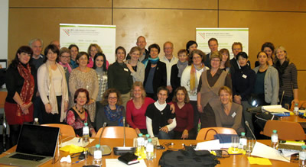
And you…
What nationality are you? It does not matter… we work in team

Slide 42

Thank you for listening
merci,
grazie,
thank you,
danke…

Slide 43
Reinvestissement with FREPA/CARAP
http://carap.ecml.at/CARAP/Video/tabid/2618/language
http://carap.ecml.at/Components/tabid/2668/language/fr-FR/Default.aspx
http://carap.ecml.at/CARAP/Descriptors/Knowledge/tabid/2407/language/fr-FR/Default.aspx
http://www.ecml.at/
http://edl.ecml.at/Home/tabid/1455/language/fr-FR/Default.aspx
Journée européenne des langues
http://edl.ecml.at/LanguageFun/tabid/1516/language/fr-FR/Default.aspx
Faits et jeux sur les langues

Slide 44
Additional ressources
Opera Lyra Ottawa, Canada http://www.operalyra.ca/learn/study-guides.php
Opéra National de Paris - http://www.operadeparis.fr/actualites/En-video-Les-Artisans-de-la-magie
Metropolitan Opera Theatre (MET) http://www.metoperafamily.org/metopera/history/stories/synopsis
L’Opéra de Lille (voir programmation de mai – Le Barbier de Séville) et le théâtre de
http://www.opera-lille.fr/fichier/o_media/9225/media_fichier_fr_dp.la.traviata.pdf
Canadian Opera Company - http://www.coc.ca/Home.aspx?gclid=CMO23tGKhq8CFYIQNAodklDO9w
Chinese Opera Group in Toronto - http://www.chineseoperagrouptoronto.ca/
Mississauga Choral Society – Education Young Listeners Program:
MCS brings non-ticketed live performances to Peel schools - http://www.mcs-on.ca/Arts_Education.html
Opéra de Montréal (mission, éducation, vidéo) - http://www.operademontreal.com/fr/educations/mission.html
Opéra de Montréal – soirée pour combattre la pauvreté - http://www.operademontreal.com/wp-content/uploads/2012/02/CommuniquéOpéra_soirée-20-mars-2012_rev17janv.pdf
Opera Milano, Teatro alla Scala – Italy - http://www.teatroallascala.org/it/stagione/opera-balletto/2011-2012/nozze-figaro_cnt_21768.html

